Slide 1
ULMFiT for Text Classification Jeremy Howard and Sebastian Ruder https://arxiv.org/abs/1801.06146
Presented by:
Shadman Shoumik (45563659)
Shivani Kukreti (45666547)
Suchith Kumar Suresh (45502897)

Slide 2
INTRODUCTION
This research paper uses Transfer Learning that can be applied to any task in NLP.
It introduces a key for fine-tuning a language model.
The significant outcomes of this research reduced the error by 18-24% on most of the datasets.

Slide 3
Original Data
Using Fast.ai to replicate the code in the research paper which is a Python library containing some popular algorithms for image classification and natural language tasks
Uses pre-trained word embeddings (hypercolumns)
Classification type: Sentiment Analysis
Using the IMDb large movie review dataset containing 25,000 observations with 3 variables (label, text, is_valid)

Slide 4
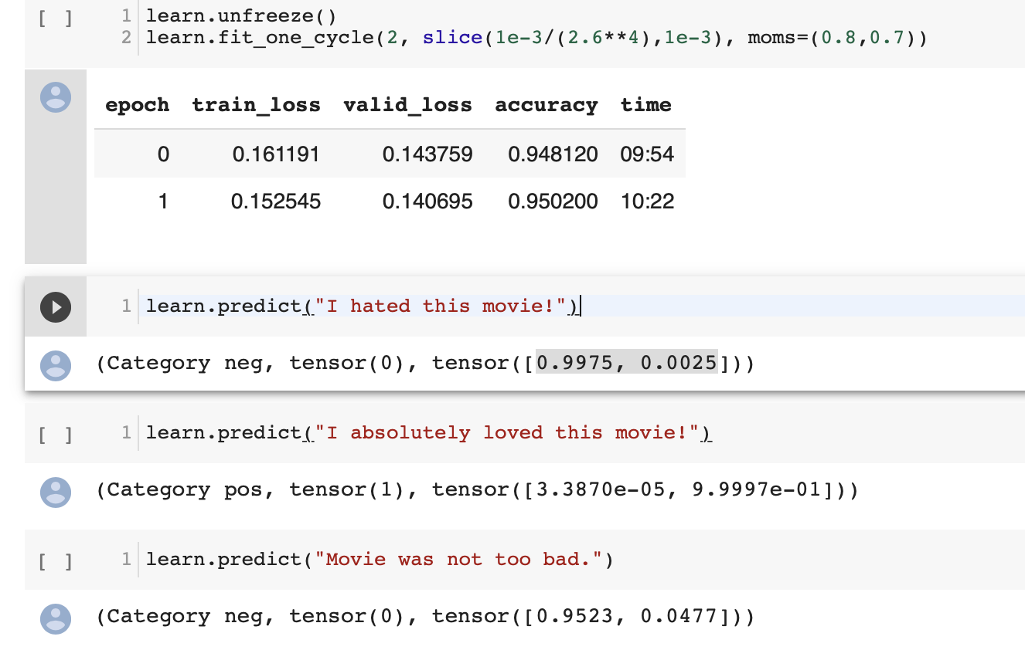
Replication on Original Data
We were able to replicate the code on the original IMDB dataset successfully.
It took about 14 hours to run the code on Colab GPU.
As the GPU training and instances were expensive on AWS, we decided to run this code on Colab as it is a credit-free platform.

Slide 5
Issues while replicating Code on the original dataset
We were unable to use AWS as it is expensive and limited credit points were available.
Running the code was a time-consuming task as it took about 14 hours to completely run.
Getting familiar with the fastai library.
Understanding Tokenization and Numericalization which is used in code.

Slide 6
NEW DATA
Data-sets containing reviews from different domains like:
Amazon Reviews: https://s3.amazonaws.com/fast-ai-nlp/amazon_review_polarity_csv.tgz
Coursera Reviews: https://www.kaggle.com/septa97/100k-courseras-course-reviews-dataset
Drug Reviews: https://archive.ics.uci.edu/ml/machine-learning-databases/00462/drugsCom_raw.zip

Slide 7
amazon REVIEW
Dataset used: Amazon Review Polarity Dataset created from the Amazon Review Dataset containing product reviews on Amazon.
The polarities have been decided based on review scores:
Score of 1 & 2: Negative i.e. Class 1
Score of 4 & 5: Positive i.e. Class 2
Products with a score of 3 were ignored.
The complete polarity dataset contains 1,800,000 training samples belonging to Class 1 and 2, respectively.
I have used 25,000 samples each from Class 1 and 2, respectively. Out of which, 10% are used for validating the model.

Slide 8
The accuracy achieved with this dataset is 86.8%. In contrast, the accuracy with the original IMDb dataset was 95.02%.
As the number of cycles would be increased, so would the accuracy. In the original code, this number is 10; however, to reduce the time of execution, we chose to keep the number of cycles at 5. Even with this, we have been able to achieve an accuracy of greater than 85% on this dataset.

Slide 9
Coursera Reviews
The Coursera course review dataset contains 100k labelled reviews for the Coursera courses.
The data is split into training set (70%) and testing set (30%) with dataset variable of courseID, review and label.
Vader Sentiment Analysis was used to generate polarities.

Slide 10
We have been able to get the language model accuracy of 88%; however, the classifier for this dataset is yet to be built.

Slide 11
Drug Reviews
The dataset provides patient reviews on specific drugs along with related conditions and rating reflecting overall patient satisfaction.
The data is split into a train (75%) and test (25%) partition with 200 thousand observation and replicate the code on this dataset.
The data used to build model is a sample taken of 50K observations.
Used Vader sentiment analysis to create the polarity labels (Positive, Negative and Neutral) based on the review score.
Only 10% of data is used for validation of the model.

Slide 12
The accuracy achieved with this dataset is 84.7%. In contrast, the accuracy with the original IMDb dataset was 95.02%.
As the number of cycles would be increased, so would the accuracy. In the original code, this number is 10; however, to reduce the time of execution, we chose to keep the number of cycles at 5. Even with this, we have been able to achieve an accuracy of greater than 80% on this dataset.

Slide 13
THANK YOU

